Slide 1
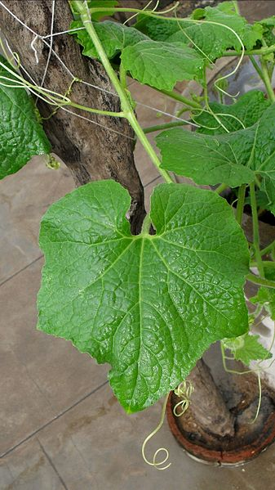
Evaluation of sample processing protocols for the analysis of pumpkin leaf metabolites
Goals: Compare different extraction and drying protocols to identify the “optimal” sample processing approach
Topics:
Data quality overview
Statistical comparisons
Power analysis
Statistics

Slide 2
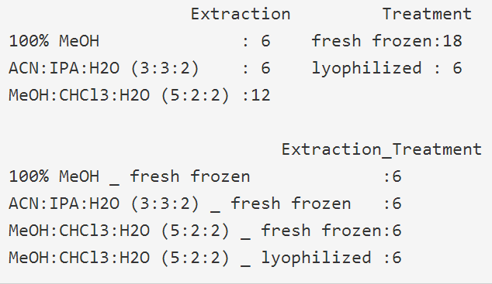
Data Quality Overview
Goal: Calculate and visualize the summary statistics for each metabolite/treatment (Use DATA: Pumpkin data 1.csv)
Calculate:
Mean and standard deviation (sd)
The percent relative standard deviation, %RSD, (sd/mean)*100
Visualize:
The relationship between mean vs. sd, mean and %RSD
Compare mean metabolite values for all treatments
Exercises:
Describe the relationship between analyte mean and sd, mean and %RSD?
Describe what constitutes an “optimal” method?
Which extraction/treatment should be chosen to process further samples?
Statistics

Slide 3
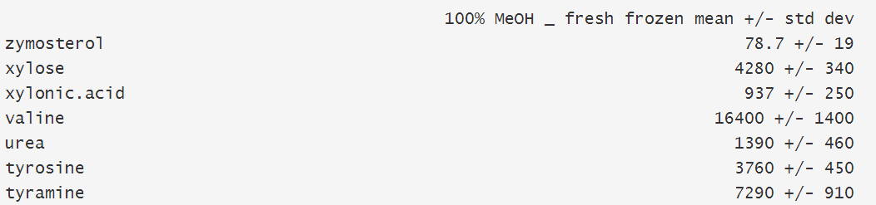
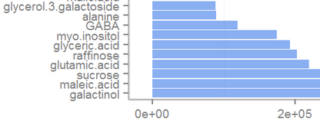
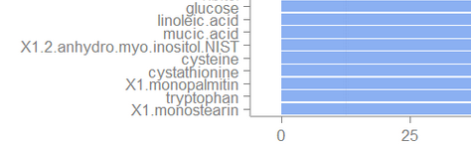
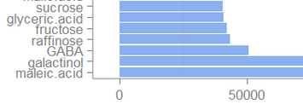
Question:
Which metabolite has the largest mean, sd and RSD for the 100% MeOH_fresh frozen extraction method?
Statistics

Slide 4
Answer:
Which metabolite has the largest mean, sd and RSD for the 100% MeOH_fresh frozen extraction method?
mean
sd
Statistics
RSD (sd/mean)*100

Slide 5
Question:
Is there a relationship between mean and sd, mean and RSD?
Statistics

Slide 6
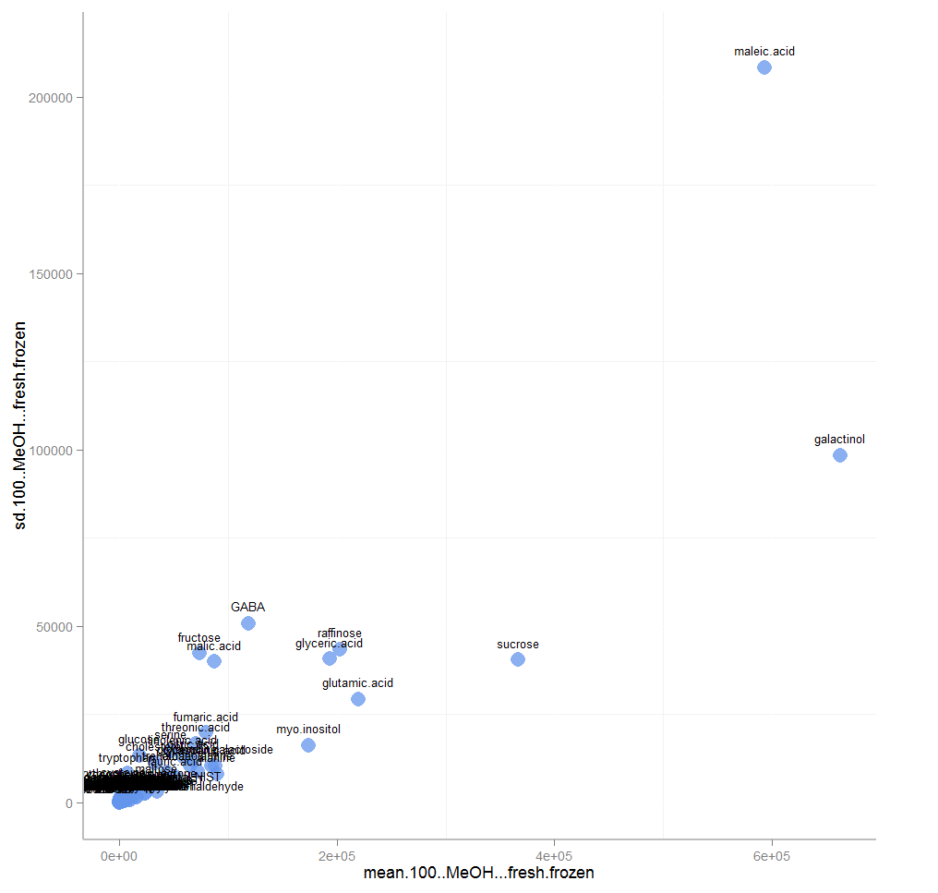
Answer:
Is there a relationship between mean and sd?
Mean and sd are highly correlated
Larger means have larger sd
This effect is also called heteroscedasticity
SD
Statistics
Mean

Slide 7
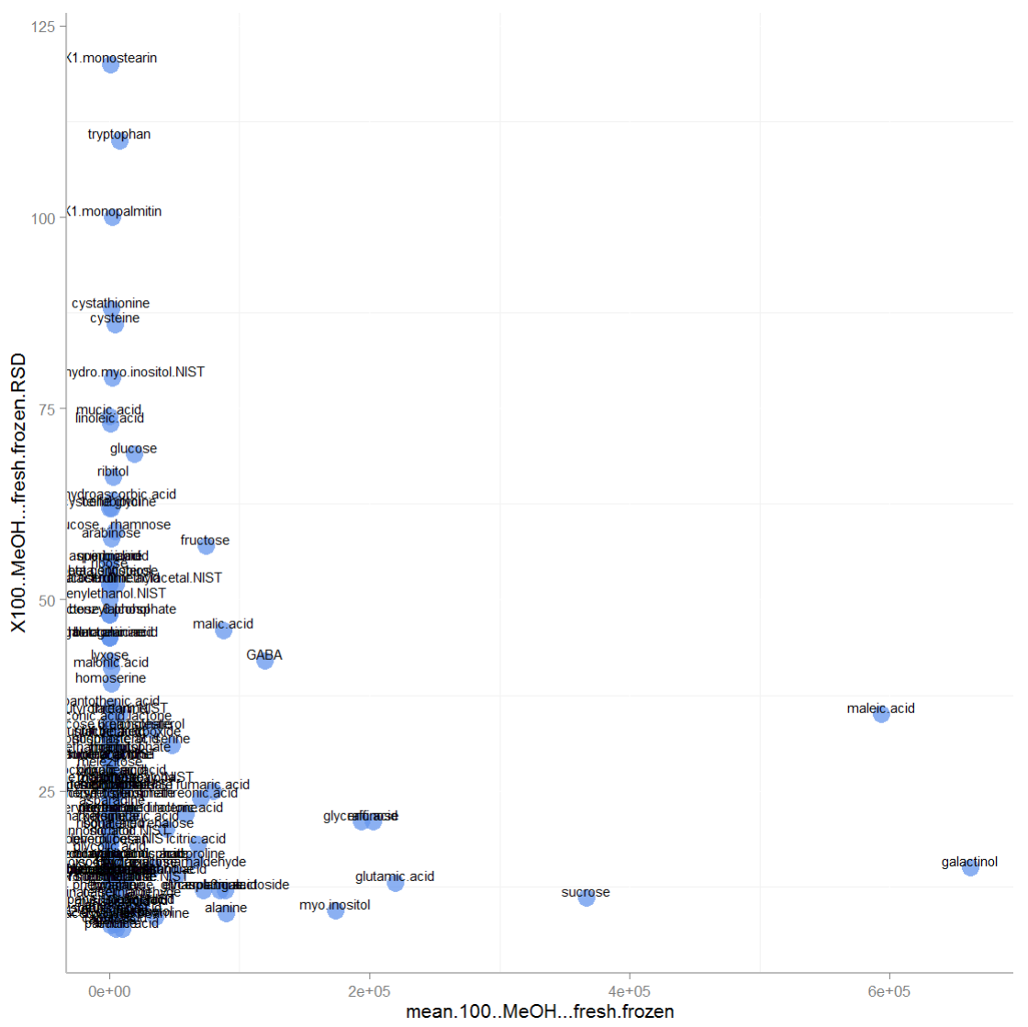
Answer
Is there a relationship between mean and RSD?
%RSD is minimally correlated with the mean, and is useful for:
Comparing method reproducibility
Identifying data quality
%RSD
Statistics
Mean

Slide 8
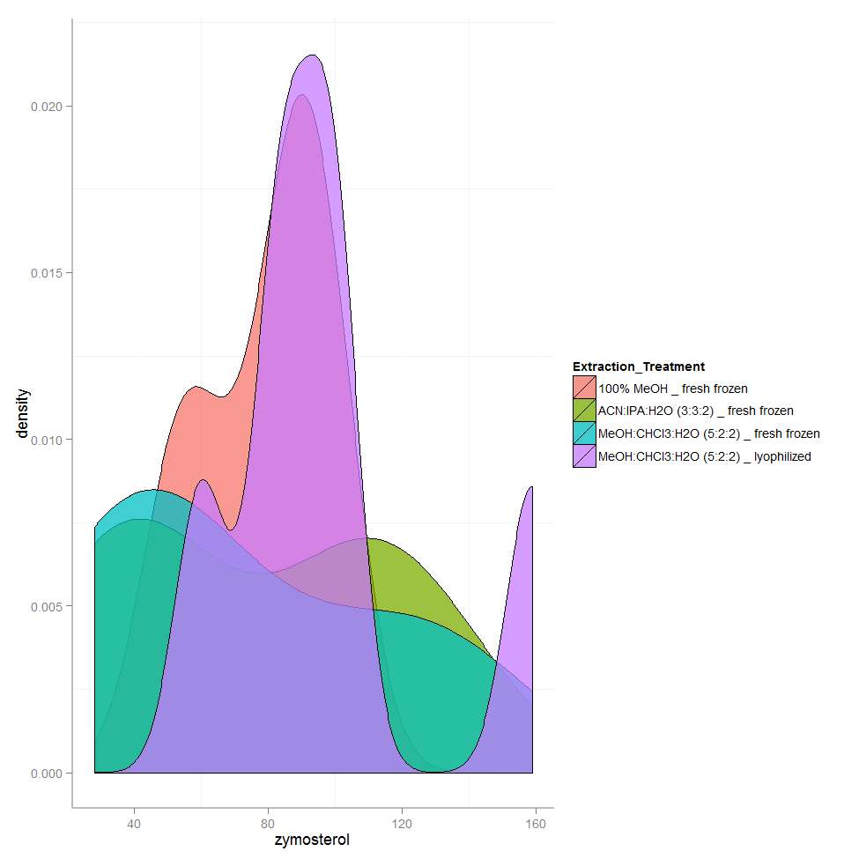
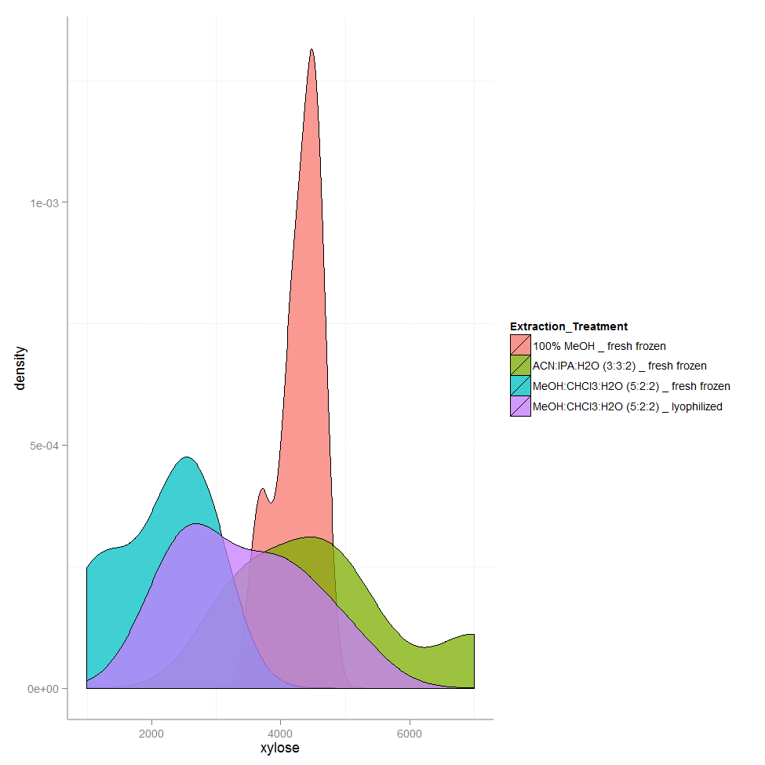
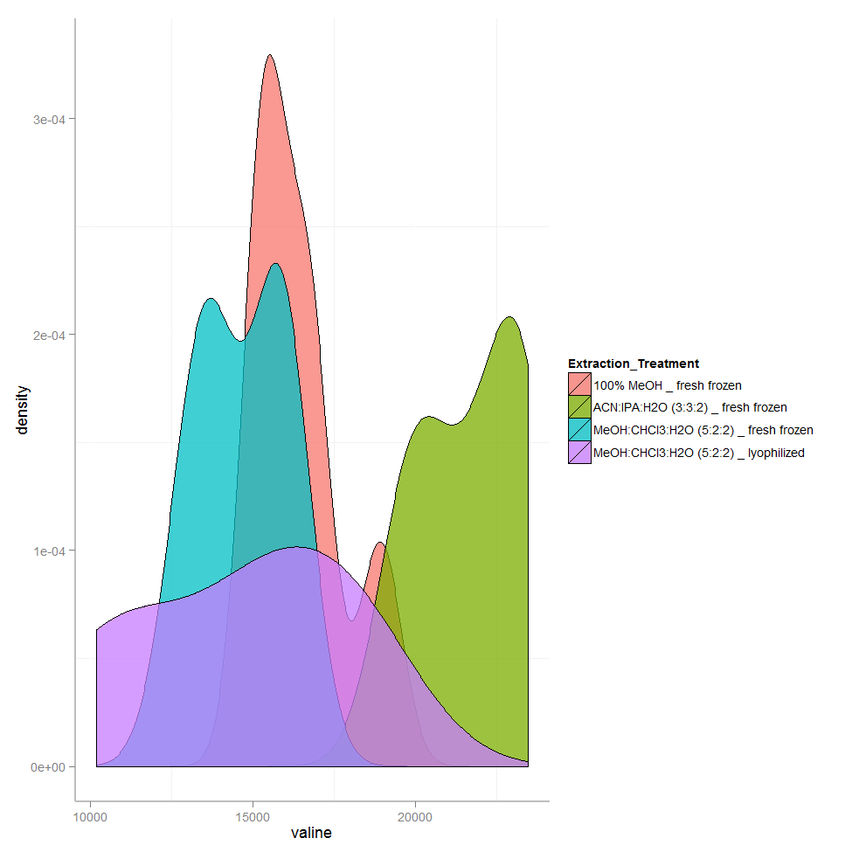
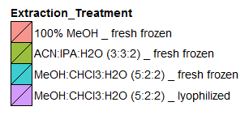
Analytical variance can be used to select optimal workup methods and flag problem analytes.
Statistics

Slide 9
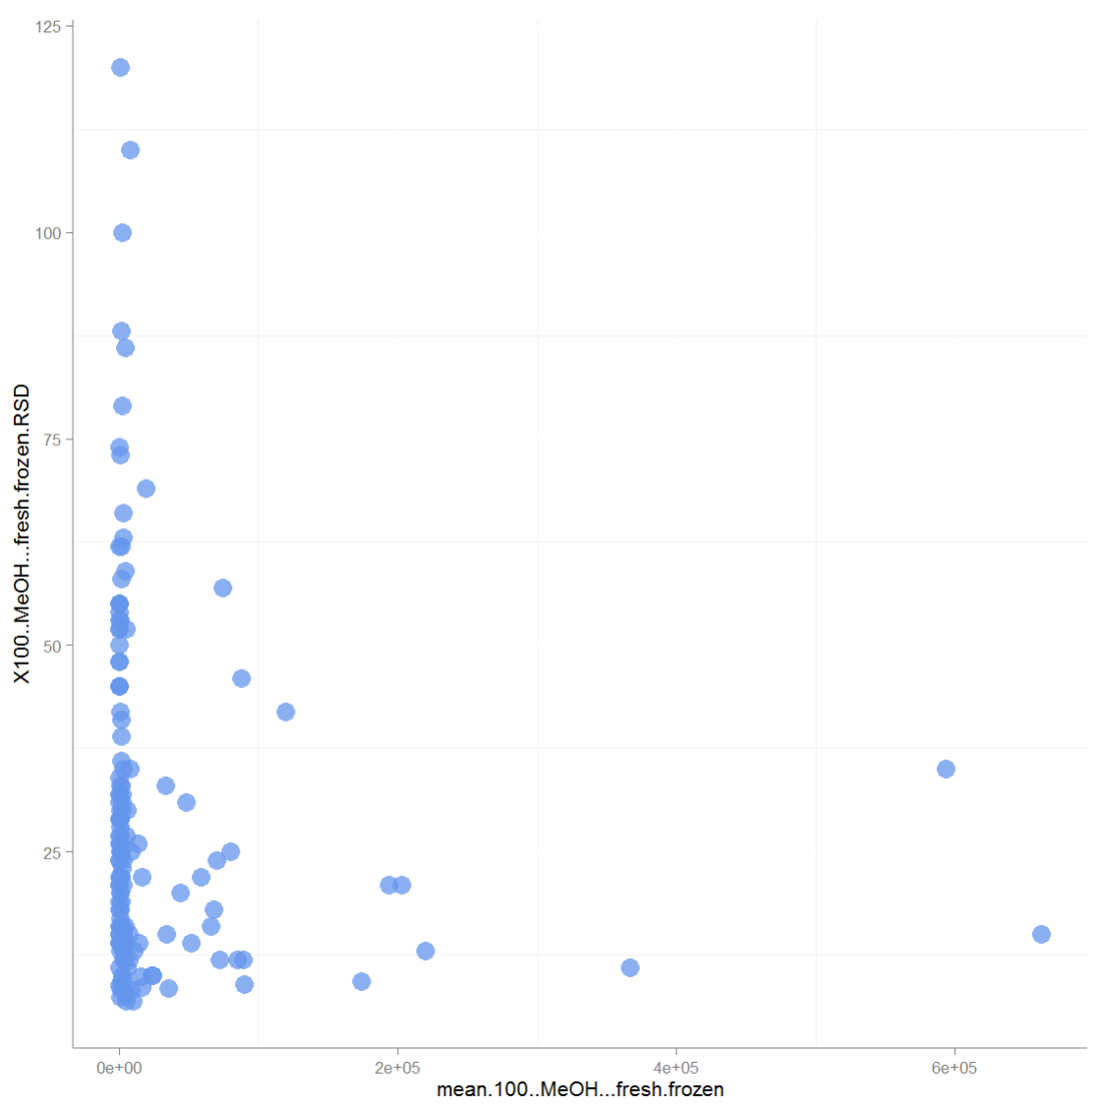
Data quality
Below LOQ (sensitivity)
%RSD
Bad
Statistics
~40%
Moderate
Good
~10,000
Mean

Slide 10
Question:
Calculate the mean RSD across all analytes for each workup method
%RSD (also called the coefficient of variation or CV) is the sd (variation) scaled by the mean (magnitude).
Removes the relationship between variation and magnitude
Provides a single value which can be used to compare the variation of a measurement among different treatments/samples
Statistics

Slide 11
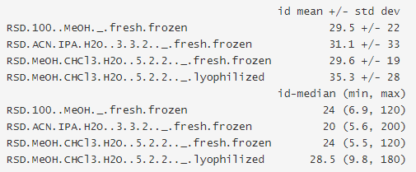
Answer:
Calculate the mean RSD across all analytes for each workup method
RSD mean +/- sd and median (min, max)
Statistics

Slide 12

Selecting the “optimal” method
Optimal can be:
Lowest average %RSD for all measurements
Lowest %RSD for measurements of interest
Largest number of metabolites passing %RSD cutoff
Lowest average %RSD for all measurements passing %RSD cutoff
Using strategy #4 for metabolites %RSD ≤ 40
Statistics
Count
%RSD (mean ± sd)
Method #2 (ACN/IPA/water 3:3:2) looks optimal…

Slide 13
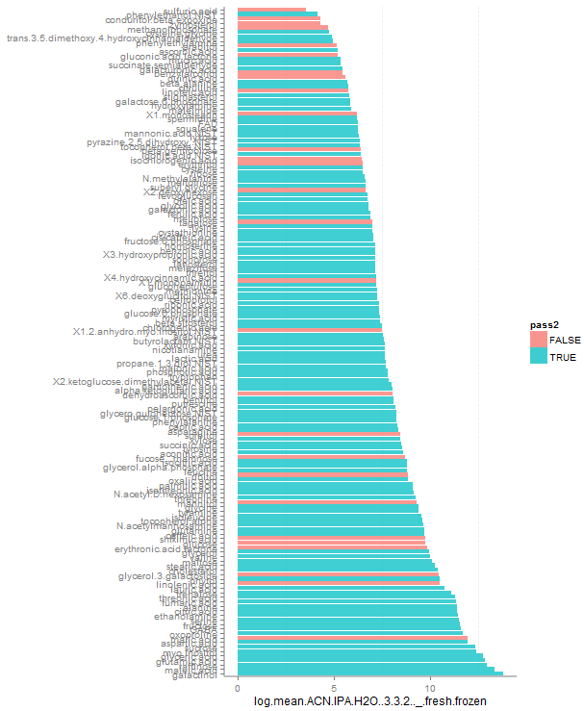
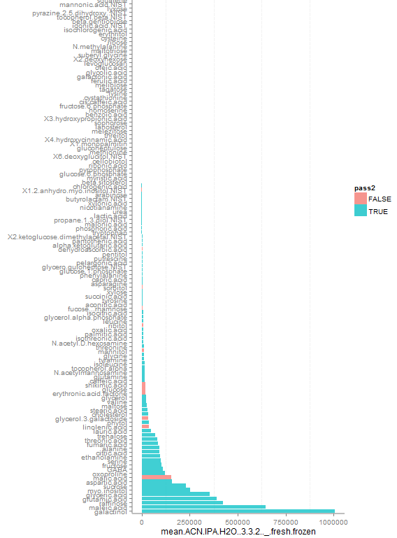
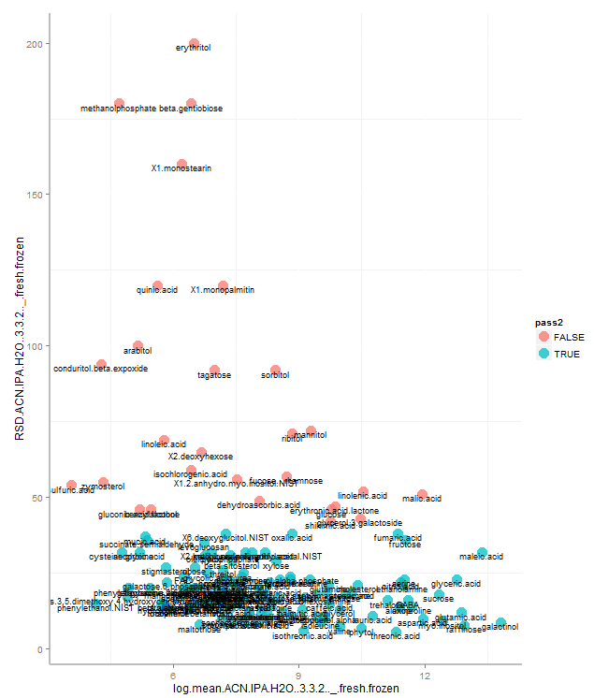
Based on Method #2
Mean
%RSD ≤ 40
Log Mean
%RSD
Statistics
Analytes with high signal and high %RSD should be further interrogated for explanations of low reproducibility
Log Mean

